Slide 1
WHEELCHAIR CONTROL THROUGH VOICE RECOGNITION USING ARDUINO BATCH NO:8 FINAL REVIEW
PRESENTED BY:
MONIKKA.R
KEERTHANA.S.J
KAVEN KUMAR.R
CSE-6A
GUIDED BY:
Dr. DEEPA.M,Ph.D, Associate Professor, CSE

Slide 2
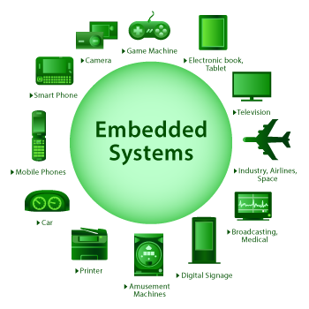
DOMAIN
Embedded systems:
An embedded system is a microprocessor-based computer hardware system with software that is designed to perform a dedicated function, either as an independent system or as a part of a large system.

Slide 3
ABSTRACT
A voice controlled wheelchair was developed to assist people with both upper and lower limb disabilities.
An Arduino microcontroller processes the voice command from the speech recognition module and controls the motor movement of the wheelchair.
Bluetooth module is used to do an optional joystick command which is incorporated into the prototype design.

Slide 4
SCOPE AND OBJECTIVES
The wheelchair is the most ubiquitous equipment used by people with upper and lower limb disabilities.
The voice recognition module is the key feature of this project that is used to setup the desired voice command and output.

Slide 5
EXISTING SYSTEM
Designing a electric wheelchair which can function and be controlled by the movement (blinking) of eyes.
Infrared sensor mounted on transparent glasses which is used to monitor the eye blinking so the person can control the movements of the wheelchair according his will.
DISADVANTAGES:
It is inconvenient for the user to control the wheelchair movements by using eye blinking.

Slide 6
PROPOSED SYSTEM
In the proposed system, we have implemented bluetooth module to control wheelchair movement by using voice recognition.
ADVANTAGES:
It is convenient for the user to control the wheelchair movements using voice recognition module.

Slide 7
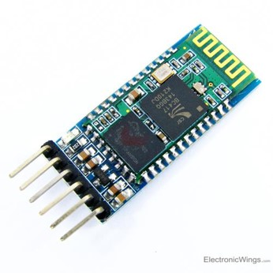
HARDWARE COMPONENTS
Bluetooth module:
HC-05 is a Bluetooth module which is designed for wireless communication. This module can be used in a master or slave configuration.
Bluetooth serial modules allow all serial enabled devices to communicate with each other using Bluetooth.

Slide 8
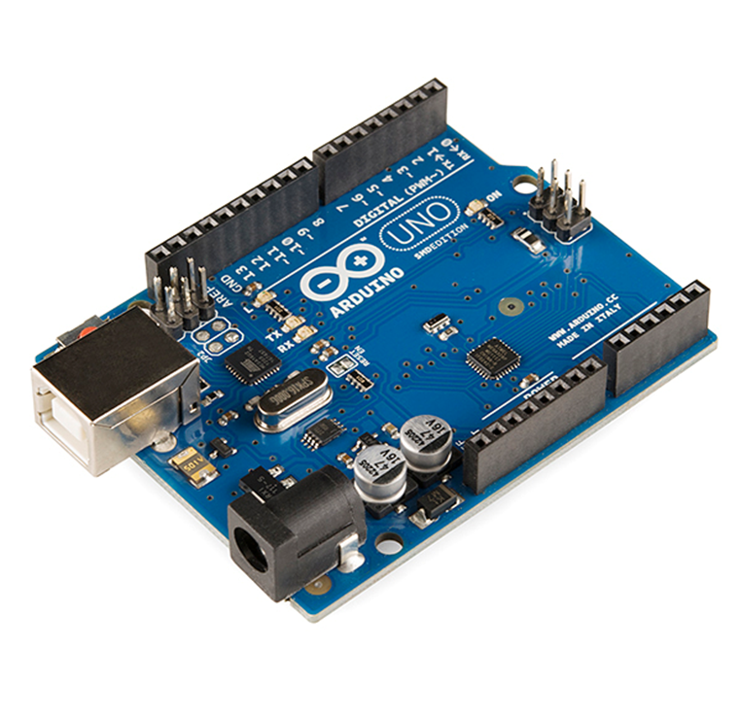
Arduino UNO board:
The Arduino UNO is an open source microcontroller board based on the Microchip ATmega328P microcontroller.
This board contains a USB interface i.e. USB cable is used to connect the board with the computer and Arduino IDE software is used to program the board.

Slide 9
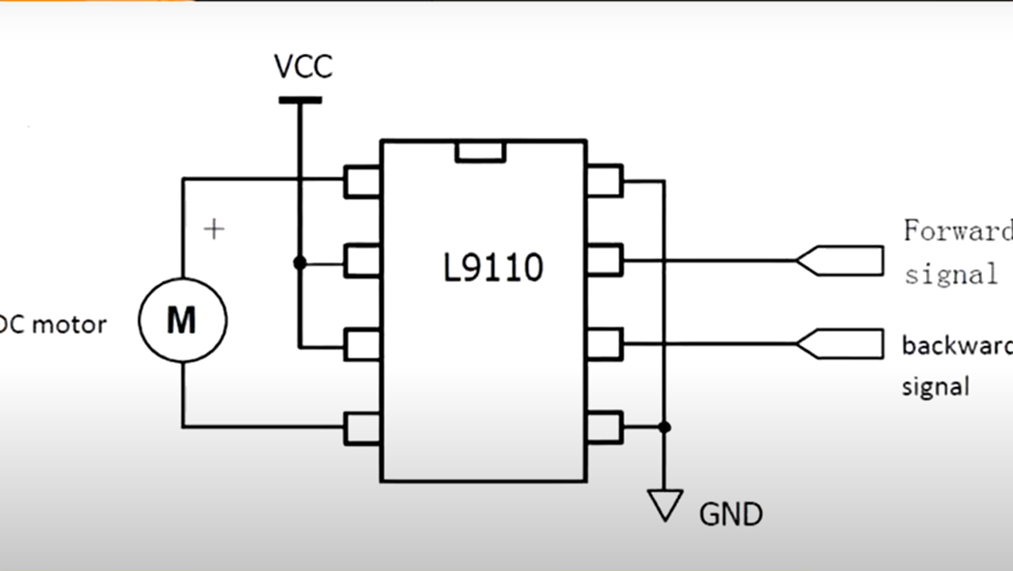
Motor Driver Circuit:
A motor driver IC is an integrated circuit chip which is usually used to control motors in autonomous robots.
Motor driver ICs act as an interface between microprocessors in robots and the motors in the robot.
It acts as an interface between the motors and the control circuits.

Slide 10
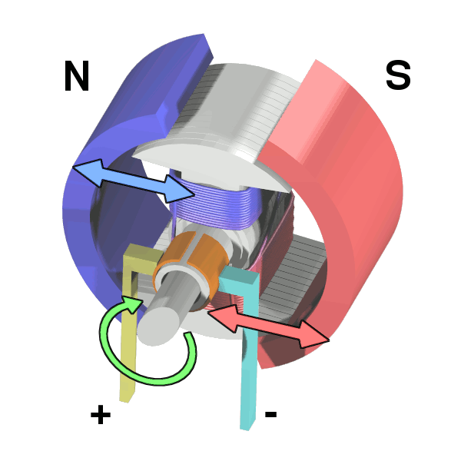
DC Motors:
A direct current (DC) motor is a type of electric machine that converts electrical energy into mechanical energy.

Slide 11
SOFTWARE COMPONENTS
Arduino IDE software:
The Arduino IDE is an open-source software, which is used to write and upload code to the Arduino boards.
The IDE application is suitable for different operating systems such as Windows, Mac OS X, and Linux.
It supports the programming languages C and C++.
IDE stands for Integrated Development Environment.

Slide 12
MODULES DESCRIPTION
BLUETOOTH MODULE:
The HC-05 Bluetooth is used in this project.
It is used receive the voice from humans to move.
PROCESS MODULE:
Arduino is used to program the code for device.
OUTPUT MODULE:
The Bluetooth device receive the voice.
It give controls to the Arduino and DC motors.

Slide 13
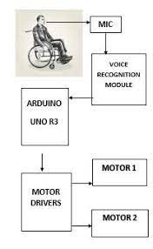
DESIGN AND IMPLEMENTATION

Slide 14
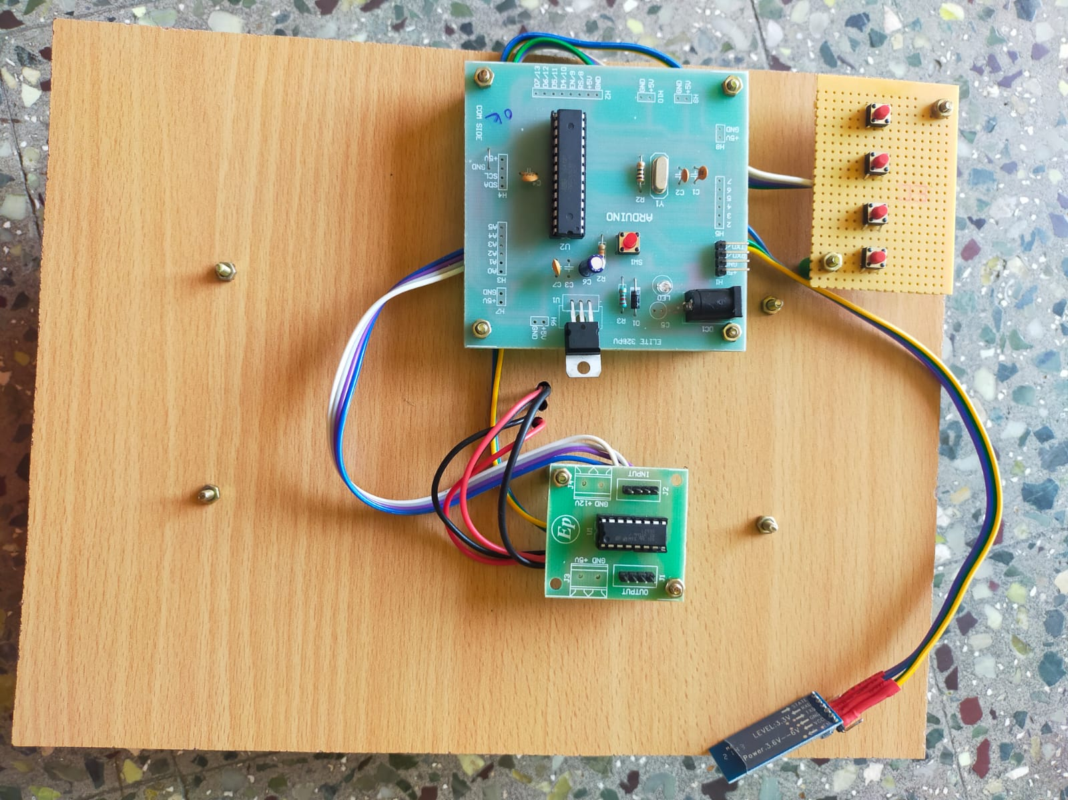
DEMO OF PROJECT:

Slide 15
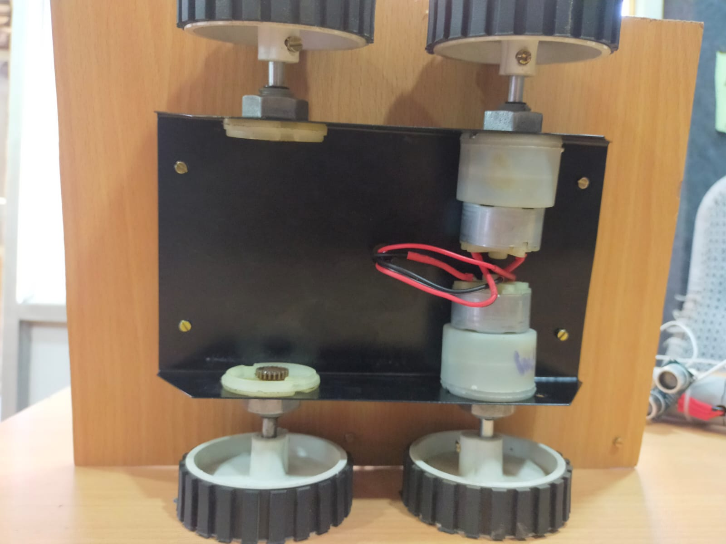

Slide 16
FUTURE SCOPE
Obstacle avoidance sensors can be interfaced.
Home appliance control circuit can interfaced along with wheel chair control.
Using gear box we can produce high speed moving wheelchair.
Solar Panel can also be used to charge the battery for power supply to the components required to drive the
wheelchair.

Slide 17
REFERENCE LINK
https://www.ijert.org/research/arduino-based-voice-operated-wheelchair-with-obstacle-detection-a-survey-IJERTCONV6IS13005.pdf
https://www.researchgate.net/publication/319442825_Voice_Controlled_Wheelchair
https://www.electroniclinic.com/voice-controlled-wheelchair-using-arduino-and-voice-recognition-module/
https://ieeexplore.ieee.org/document/8288954

Slide 18


